Slide 1
NIST FRAMEWORK
The Computer Security Resource Center (CSRC) website guides users to NIST resources on computer, cyber, and information security and privacy.

Slide 2
NIST FRAMEWORK
Its content includes publications, projects, research, news and events from the NIST Information Technology Laboratory's (ITL) two security divisions

Slide 3
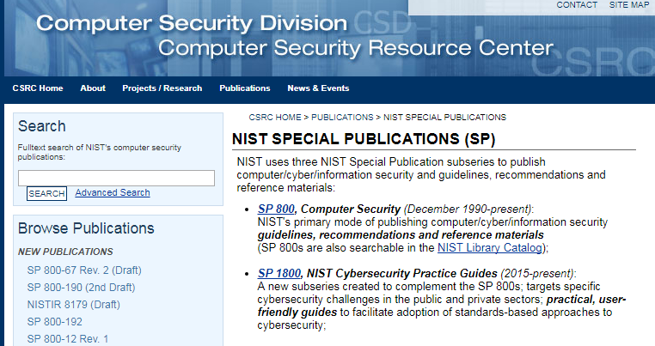
NIST FRAMEWORK

Slide 4
NIST FRAMEWORK
SP 800, Computer Security (December 1990-present): NIST's primary mode of publishing computer/cyber/information security guidelines, recommendations and reference materials (SP 800s are also searchable in the NIST Library Catalog);

Slide 5
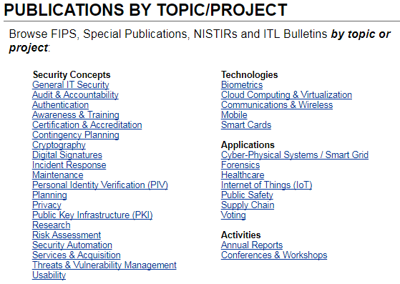
NIST FRAMEWORK

Slide 6
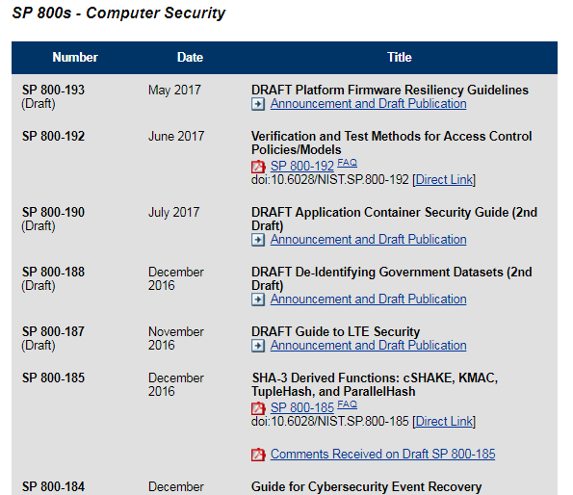
NIST FRAMEWORK

Slide 7
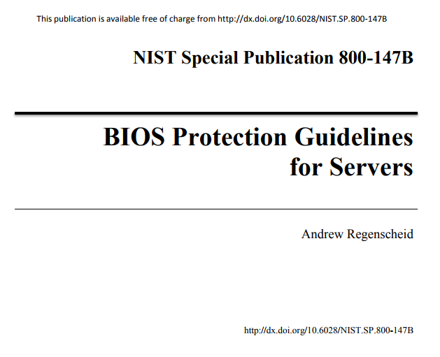
NIST FRAMEWORK
AUGUST 2014
32 PAGES DOC

Slide 8
NIST FRAMEWORK
NIST has a tremendous library of free documentation on a diverse range of topics
Relevance is often average, however, depth and detail of material is extra-ordinary
END

